Slide 1


Introduction to C Programming
Nazrin Dolkhanova Sultanli
Programming and Computer Applications – 1

Slide 2



Agenda
Introduction
Compiling
Variable names
Data Types and Sizes
Constants
Declarations
Arithmetic operators
Relational and logical operators
Type conversions
Increment & Decrement operators

Slide 3
Introduction
#include <stdio.h> int main() { // output a line printf("Hello World!\n"); }
The Semicolon:
All statements, like the printf() statement, need to end with a semicolon. This identifies the end of the statement and is needed for the code to run correctly.
Double Quotes
The text in between the double quotes " is known as a string (think of a string of characters). All strings must be surrounded by double-quotes.
Error
The below text is an error that is output when we leave off the semicolon from the printf() statement in our Hello World code.
When this code is run the following text is displayed in the terminal.
Hello World!
Let’s go through the code line by line to see what is happening. You don’t need to understand everything right away, this is just a first look.
#include <stdio.h>: This line is needed to run the line of code that starts with printf.
int main(){ }: This is the starting point of the code. All the code inside the curly braces {} runs first.
// output a line: This is a comment. It is not a line of code but a message we can add to code to tell ourselves or others what the code does. When the code is run this line will be ignored.
printf("Hello World!");: This line of code prints, or outputs, the text “Hello World!” to the console. Printing text to the console is one way for a program to communicate with the user.
script.c: In function ‘main’: script.c:6:1: error: expected ‘;’ before ‘}’ token } ^
The text above gives the following information:
The component location, In function ‘main’
The line and column number, 6:1
A description, expected ‘;’ before ‘}’
As we can see the message does its best to help us solve the errors in our code.

Slide 4
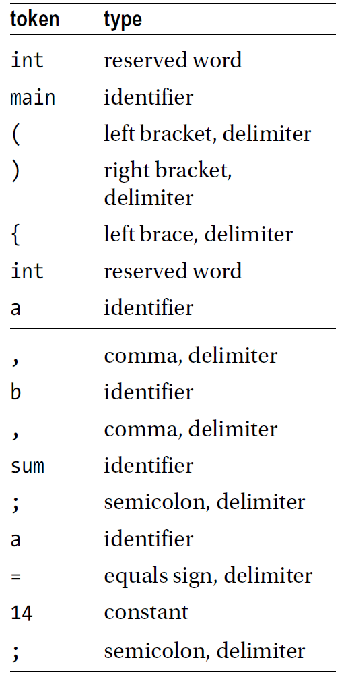
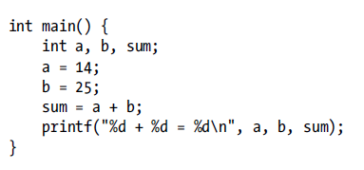
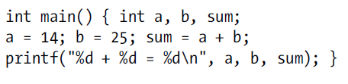
Introduction
The tokens of a language are the basic building blocks that can be put together to construct programs. A token can be a reserved word (such as int or while), an identifier (such as b or sum), a constant (such as 25 or "Alice in Wonderland"), a delimiter (such as } or ;) or an operator (such as + or =).
Therefore we can think of a program as a stream of tokens, which is precisely how the compiler views it. So that, as far as the compiler is concerned, the above could have been written like this:

Slide 5
Compiling
The compiler is the program that converts your code to an executable program that can be run on your computer. This involves reading the code from a file and compiling it into code the computer processor can run.
A widely used C Compiler is gcc, which stands for GNU Compiler Collection. Let’s look at how we can compile helloWorld.c to the helloWorld executable.
The above command can be broken up into 3 pieces:
gcc is how we run the compiler application.
helloWorld.c is the filename of our code to be compiled.
-o helloWorld is an optional but common addition to the command. It tells gcc to output the program executable under the name helloWorld. If this is left out, the executable file will be called a.out.
After running the command we have an executable, but how do we run our code? We can run the executable with the following command, again using the terminal:
// helloWorld.c #include <stdio.h> int main() { // output a line printf("Hello World!\n"); }
To compile this code we need to run the following command in a terminal:
./helloWorld
This command tells the computer to look in the current directory and run helloWorld.
gcc helloWorld.c -o helloWorld

Slide 6

Topic one
Introduction to C Programming

Slide 7
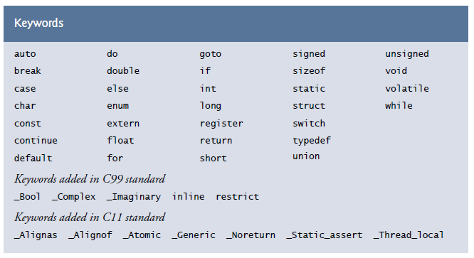
1.1 Variable names
type variable_name;
Names are made up of letters and Digits
The first character must be letter
The underscore “_” counts as a letter
Do not begin variable names with underscore
Case sensitive
Traditional C practise is to use lower case for variable names and all uppercase for symbolic constants
Keywords like if, else, int, float etc.., are reserved: you can't use them as variable names. They must be in lower case

Slide 8
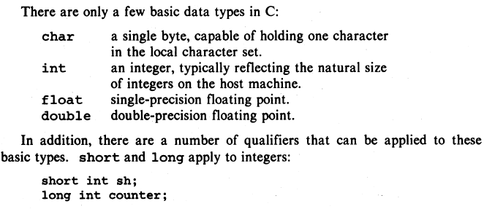
1.2 Data Types and Sizes
Type | Storage size | Value range
char | 1 byte | -128 to 127 or 0 to 255 stores one character (letter or number)
unsigned char | 1 byte | 0 to 255
signed char | 1 byte | -128 to 127
int | 2 or 4 bytes | -32,768 to 32,767 or -2,147,483,648 to 2,147,483,647
unsigned int | 2 or 4 bytes | 0 to 65,535 or 0 to 4,294,967,295
short | 2 bytes | -32,768 to 32,767
unsigned short | 2 bytes | 0 to 65,535
long | 8 bytes or (4bytes for 32 bit OS) | -9223372036854775808 to 9223372036854775807
unsigned long | 8 bytes | 0 to 18446744073709551615
Type | Storage size | Value range | Precision
float | 4 byte | 1.2E-38 to 3.4E+38 | 6 decimal places
double | 8 byte | 2.3E-308 to 1.7E+308 | 15 decimal places
long double | 10 byte | 3.4E-4932 to 1.1E+4932 | 19 decimal places
Float and Double, What's the Difference?
A float has less precision than a double, 6 vs 15 possible decimal places respectively, and therefore takes up less memory (4 vs 8 bytes). However, a double run faster, so you gain speed at the cost of more memory usage.

Slide 9
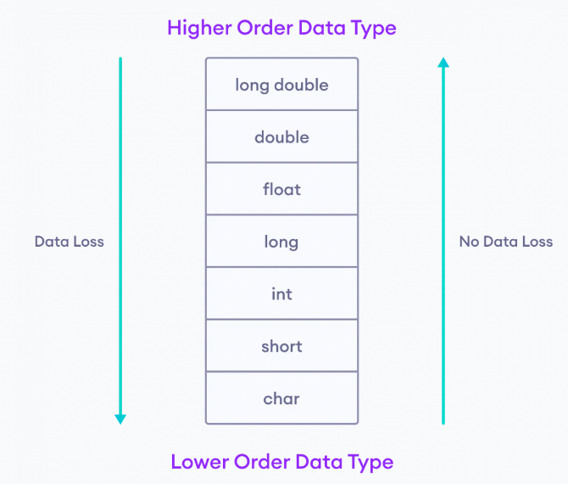
1.2 Data Types and Sizes
Format Specifier | Type
%c | Character
%d | Signed integer
%f | Float values
%i | Unsigned integer
%l or %ld or %li | Long
%lf | Double
%o | Octal representation
%p | Pointer
%s | String
%u | Unsigned int
%x or %X | Hexadecimal representation
%n | Prints nothing
%% | Prints % character
To get the exact size of a type or a variable on a particular platform, you can use the sizeof operator. The expressions sizeof(type) yields the storage size of the object or type in bytes.
C String
Unlike many other programming languages, C does not have a String type to easily create string variables. However, you can use the char type and create an array of characters to make a string in C.
Note that you have to use double quotes.
To output the string, you can use the printf() function together with the format specifier %s to tell C that we are now working with strings.
You should also note that you can create a string with a set of characters. This example will produce the same result as the one above.
char greetings[] = "Hello!"; printf("%s", greetings); //Hello!
printf("%c", greetings[0]); //‘H’
char greetings[] = {'H', 'e', 'l', 'l', 'o', '!', '\0’};
printf("%s", greetings); //Hello!
data loss - if long double type is converted to double type
no data loss - if char is converted to int

Slide 10
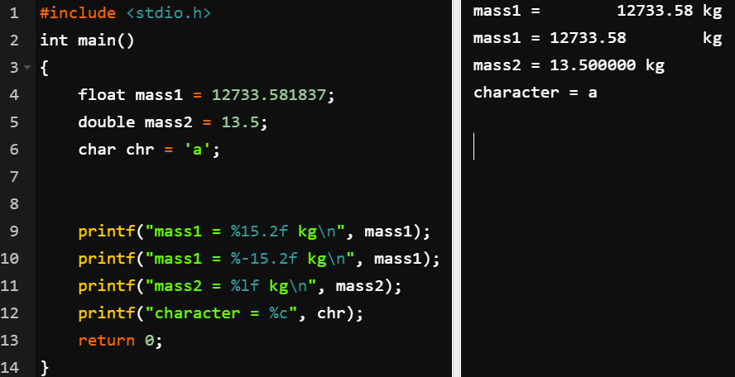
1.2 printf
We have used printf to print string constants, integer values, and floating-point values. And we have printed values with and without field widths. We have also seen how to use the escape sequence \n to force output onto a new line. It is worth emphasizing that the characters in the format string are printed exactly as they appear except that a format specification is replaced by its corresponding value. For example, if a is 25 and b is 847, consider the statement:
printf("%d%d\n", a, b);
This will print
25847
The numbers are stuck together and we cannot tell what is a and what is b! This is so because the specification %d%d says to print the numbers next to each other. If we want them separated by one space, say, we must put a space between %d and %d, like this:
printf("%d %d\n", a, b);
This will print
25 847
You can also control the decimal precision, which is the number of places after the decimal. Output will round to the appropriate number of decimal places.
Field width can also be controlled.
In the conversion specifier, the number before the decimal is field width, and the number after is the precision
printf(“ % width . precision f \n", variable);
%-9.0 would left-justify in a field width of 9

Slide 11
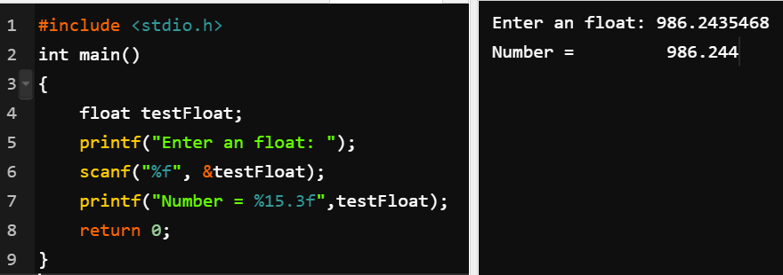
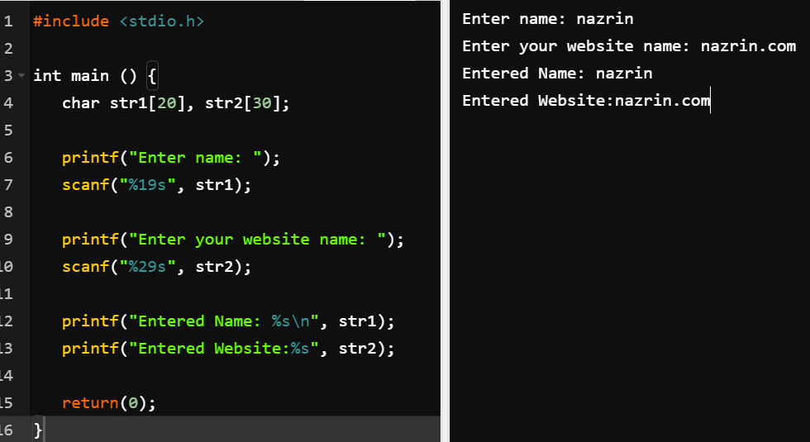
1.2 scanf
causes the computer to wait for the user to type a number. The statement works in a similar manner:
scanf("%d", &b);
The statement consists of:
The word scanf
Left and right brackets
Two items (called arguments) inside the brackets, separated by a comma
As with printf, the first item is a string called the format string. In this example, the string consists of the format specification %d only. It specifies the type of data to be read. Here, %d is used to indicate that an integer value is to be read.
The second argument specifies where to store the value read. Even though we want the value stored in a, scanf requires us to specify this by writing &a. The quick explanation is that we must tell scanf the address of the memory location where the value is to be stored; &a stands for “address of a.” You will need to take it on faith that in order to read a value into a variable using scanf, the variable must be preceded by &, as in &a and &b. Note that this applies to the scanf statement only.
We can use scanf to read more than one value at a time:
scanf("%d %d %d", &a, &b, &c);
When this statement is executed, it looks for three integers. The first one is stored in a, the second in b, and the third in c. It is up to the user to ensure that the next three items in the data are integers. If this is not so, an “Invalid numeric format” message will be printed and the program will crash. When entering the data, the numbers must be separated by one or more spaces, like this:
42 -7 18
Please note: if we enter a name longer than 20 characters, or a website longer than 30, it will overflow the buffers provided. And if we enter a name longer than 19 characters, or a website longer than 29, then printf will not find a trailing null byte, so it will start reading other parts of the stack and random garbage - in other words a buffer overrun.
So in this one code example you have both a buffer overflow and a buffer overrun. In many cases a vulnerability like this is enough to compromise an application written in C.
We should use %19s and %29s instead of %s to prevent this vulnerability. It will cut off the extra characters, but it will be safe.

Slide 12
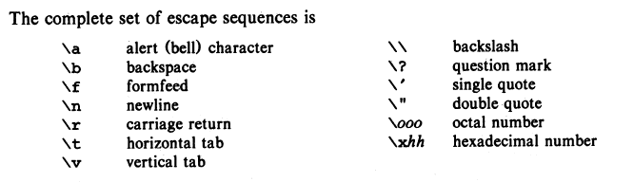


1.3 Constants
Escape sequences:
A constant is a name given to the variable whose values ​​can't be altered or changed . A constant is very similar to variables in the C programming language, but it can hold only a single variable during the execution of a program.

Slide 13
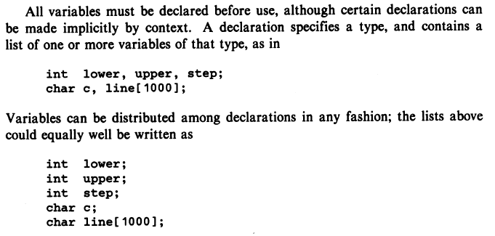
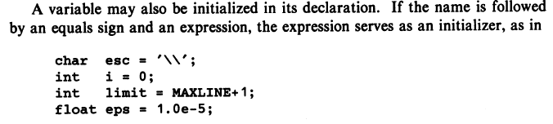
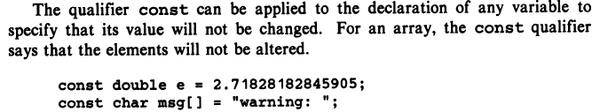
1.4 Declarations

Slide 14
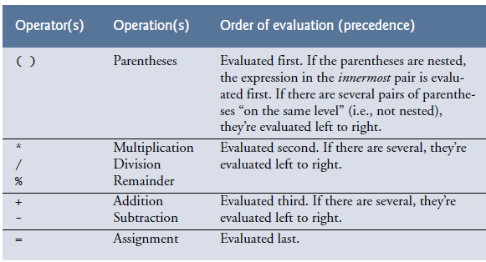
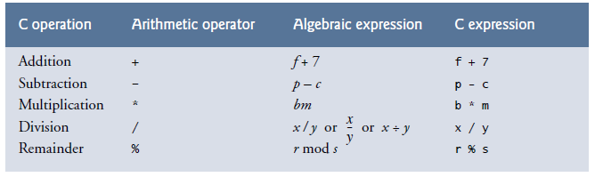
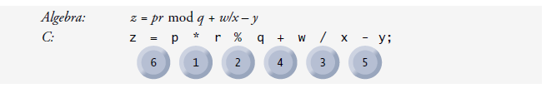
1.5 Arithmetic operators
Operator | Example | Same as
= | a = b | a = b
+= | a += b | a = a+b
-= | a -= b | a = a-b
*= | a *= b | a = a*b
/= | a /= b | a = a/b
%= | a %= b | a = a%b

Slide 15
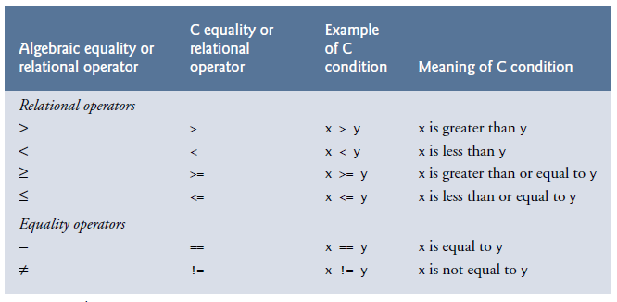
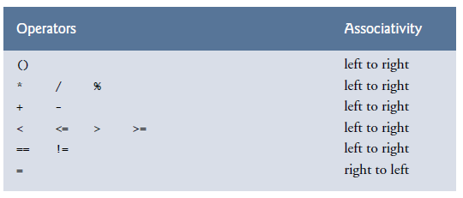
1.6 Relational and logical operators
Operator | Meaning of Operator | Example
== | Equal to | 5 == 3 is evaluated to 0
> | Greater than | 5 > 3 is evaluated to 1
< | Less than | 5 < 3 is evaluated to 0
!= | Not equal to | 5 != 3 is evaluated to 1
>= | Greater than or equal to | 5 >= 3 is evaluated to 1
<= | Less than or equal to | 5 <= 3 is evaluated to 0
Operator | Meaning | Example
&& | Logical AND. True only if all operands are true | If c = 5 and d = 2 then, expression ((c==5) && (d>5)) equals to 0.
|| | Logical OR. True only if either one operand is true | If c = 5 and d = 2 then, expression ((c==5) || (d>5)) equals to 1.
! | Logical NOT. True only if the operand is 0 | If c = 5 then, expression !(c==5) equals to 0.

Slide 16
1.7 Type conversions
Implicit type conversion
Explicit type conversion
the value of one type is automatically converted to the value of another type.
we manually convert values of one data type to another type.
type var2 = var1;
type var2 = (type) var1
// An example of implicit conversion
#include<stdio.h>
int main()
{
int x = 10; // integer x
char y = 'a'; // character c
// y implicitly converted to int.
// ASCII
// value of 'a' is 97
x = x + y;
// x is implicitly converted to float
float z = x + 1.0;
printf("x = %d, z = %f", x, z);
return 0;
}
// C program to demonstrate explicit type casting
#include<stdio.h>
int main()
{
double x = 1.2;
// Explicit conversion from double to int
int sum = (int)x + 1;
printf("sum = %d", sum);
return 0;
}
Output:
x = 107, z = 108.000000
Output:
sum = 2

Slide 17
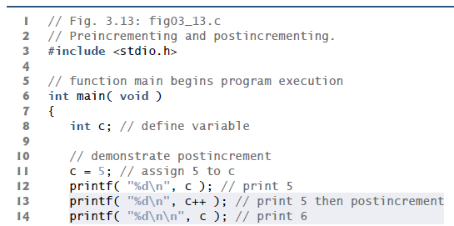
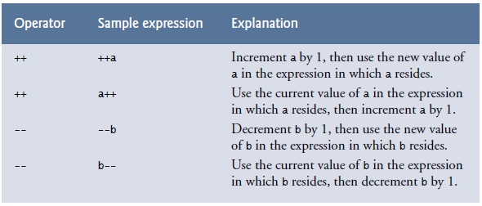
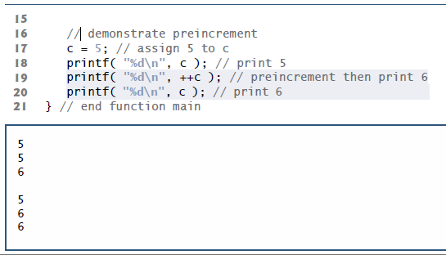
1.8 Increment Decrement operators
C programming has two operators increment ++ and decrement -- to change the value of an operand (constant or variable) by 1.
Increment ++ increases the value by 1 whereas decrement -- decreases the value by 1. These two operators are unary operators, meaning they only operate on a single operand.

Slide 18

References
Each Reference is indicated on the footer on each slide.
Books:
The_C_Programming_Language_(2nd_Edition_Ritchie_Kernighan)
Learn to Program with C_ Learn to Program using the Popular C Programming Language (Noel Kalicharan)
C How to Program, 8th edition, Paul Deitel and Harvey Deitel, Pearson, 2016.

Slide 19


Thank You
Nazrin Dolkhanova Sultanli
Nazrin.Sultanli.Dolkhanova@bhos.edu.az
Baku Higher Oil School

